Slide 1
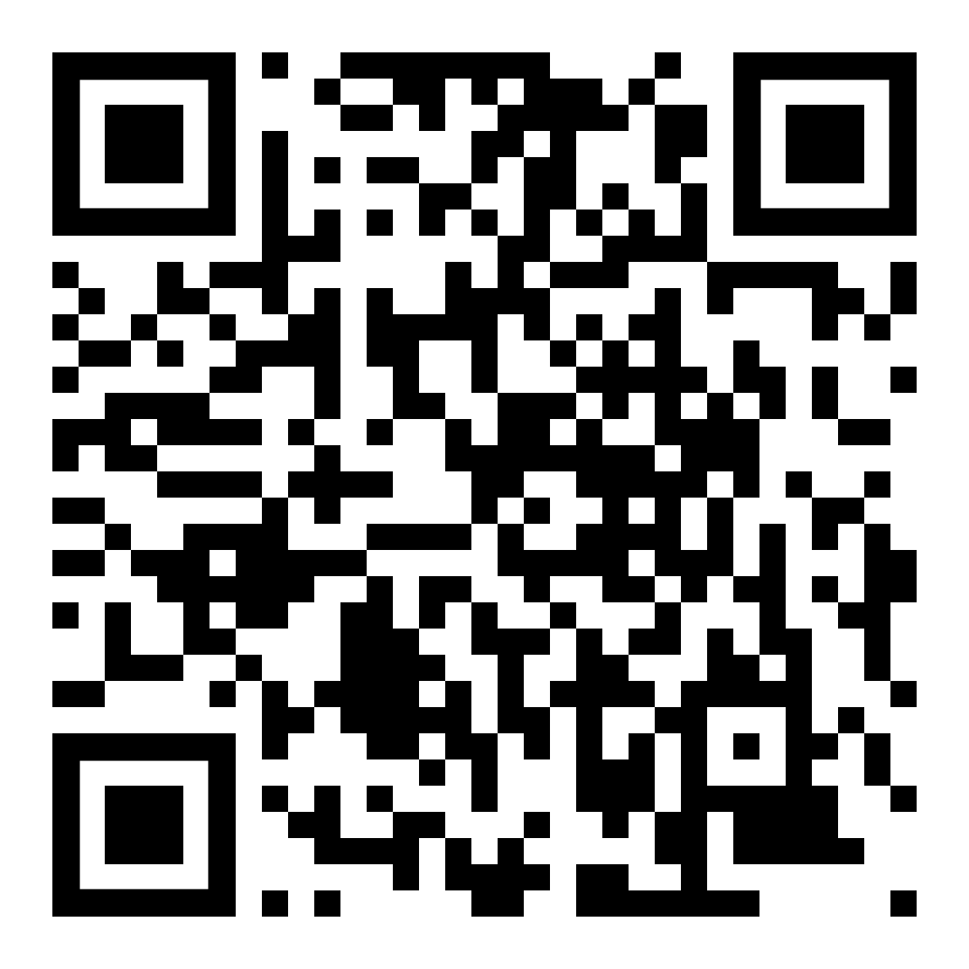


Robust and Reproducible AI:
Statistical Foundations for Machine Learning in Medical Imaging
Ernest (Khashayar) Namdar
Pascal N. Tyrrell
https://github.com/knamdar/Robust_and_Reproducible_AI

Slide 2

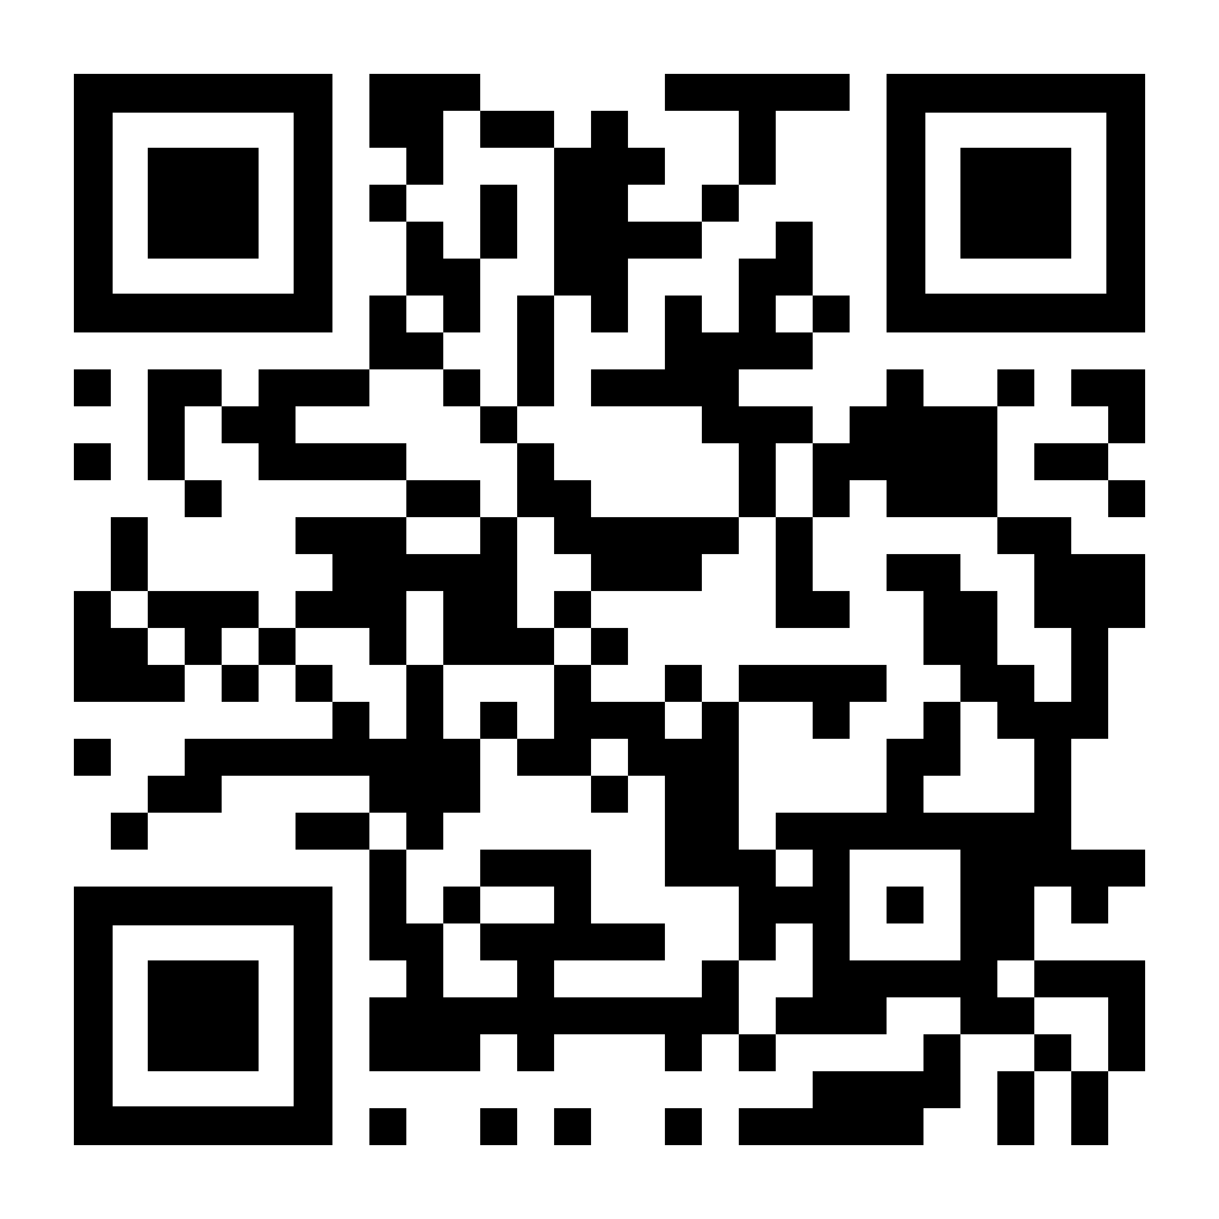
Ernest (Khashayar) Namdar
Postdoctoral Fellow @ University of Toronto
Postdoctoral Fellow @ Dalhousie University
Senior Data Analyst @The Hospital for Sick Children (SickKids)
Ambassador in AI for Healthcare @ NVIDIA Deep Learning Institute
P.Eng license holder in Software Engineering
ernest.namdar@utoronto.ca

Slide 3
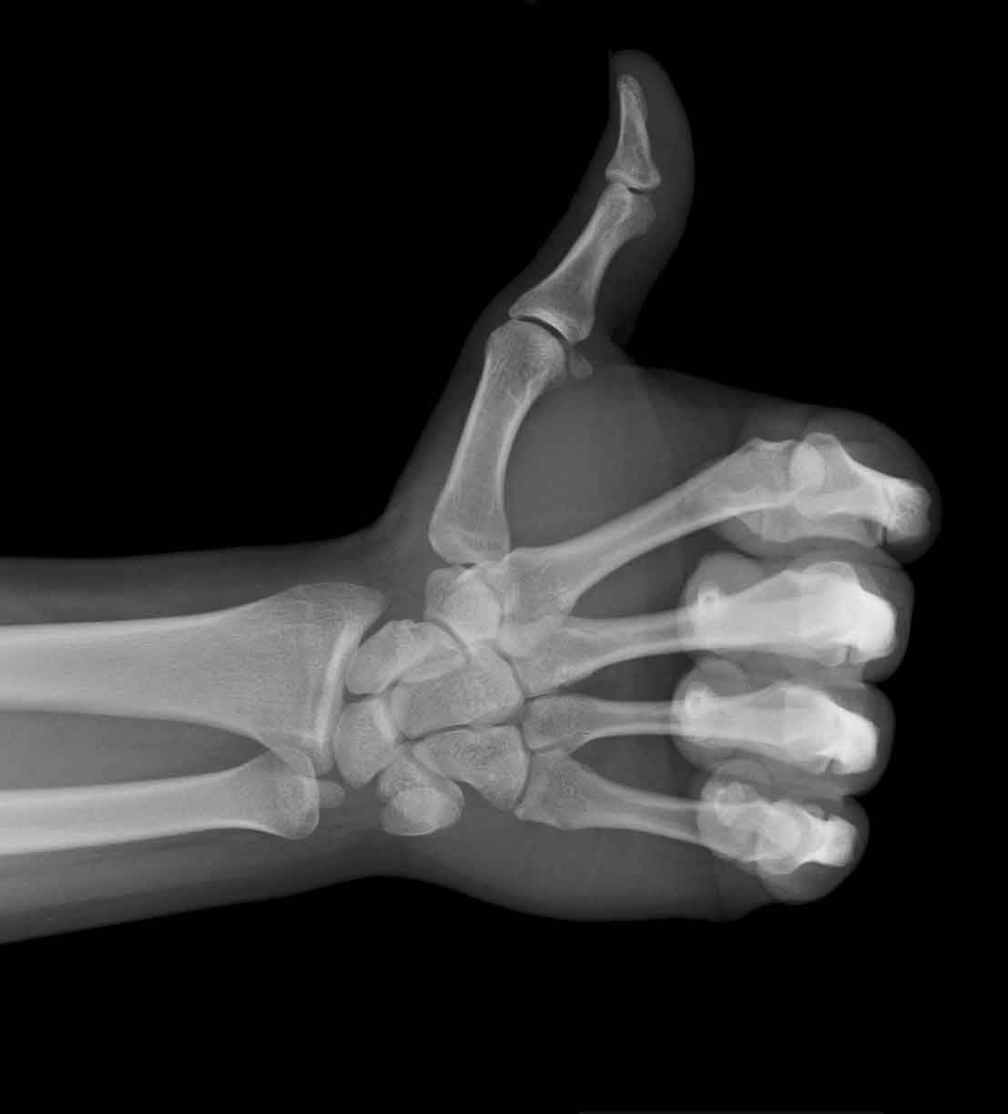




Pascal Tyrrell PhD
Data Scientist
University of Toronto
Director, Data Science - Department of Medical Imaging
Director, EDIIA - Institute of Medical Science
Temerty Faculty of Medicine
Associate Professor - Department of Statistical Sciences Faculty of Arts & Science
Faculty Affiliate
Schwartz Reisman Institute for Technology & Society
Faculty Fellow - Community-Engaged Learning
Centre for Community Partnerships
Associate Member - Yeates School of Graduate & Postdoctoral Studies
Toronto Metropolitan University
Visiting Professor - School of Medicine
University of Costa Rica

Slide 4
Statistical Foundations for Trustworthy AI in Medical Imaging
[1] Park SH, Han K. Radiology. 2018.
[2] Tang A et al. CARJ 2018
[3] Kocak B et al. Eur Radiol. 2021.
Notes:
(Self-Introduction)
Hi everyone, I'm Pascal Tyrrell, Director of Data Science in Medical Imaging at the University of Toronto.
(Workshop Purpose)
Welcome. We've all seen the incredible claims of AI in medical imaging. But we've also seen models that fail the moment they're tested in a new hospital. This workshop is about fixing that. We're going to cover the essential statistical principles needed to build AI tools that are robust, reproducible, and ready for clinical trust.
We'll move beyond just "accuracy" and focus on the foundations:
• How do we know we have enough data?
• How do we really know if our model is generalizable?
• How can we be sure a model's "confidence" is trustworthy?
• And how do we prove a model is actually helpful for patients?
We'll walk through these concepts with a focus on practical steps you can apply to your own research.

Slide 5
The Core Problem: A Crisis of Trust
• The Claim: 95% Accuracy!
• The Reality: Fails in a new hospital.
Why?
• Overestimation: The 95% was probably wrong
• Spectrum Bias: The model trained on "easy" cases
• Lack of Robustness: The model learned scanner artifacts.
• Uncalibrated: The model's "confidence" was meaningless
References:
[1] Park SH, Han K. Radiology. 2018. [3] Kocak B et al. Eur Radiol. 2021.
Notes:
This is the core problem, what I call the "Crisis of Trust." We see a paper claiming 95% accuracy. But when that model is tested at another site, its performance plummets.
Why does this happen?
1. Overestimation: Likely an illusion due to internal validation [1].
2. Spectrum Bias: Data doesn't reflect real-world population [1].
3. Lack of Robustness: Model learns scanner, not disease.
4. Uncalibrated Confidence: Confidence not meaningful [1, 3].

Slide 6
Our Goal: A Statistically Robust Pipeline
1. Design: Do we have enough data?
2. Data Handling: Is our validation honest?
3. Modelling: Is our model's confidence real?
4. Reporting: Is our model helpful and reproducible?
Notes:
Our goal today is to fix this by embedding statistical thinking at every stage of the pipeline.

Slide 7
Concept 1: Proper Validation
• Internal Validation (Not a final test): Cross-Validation, may overestimate
• External Validation (The real test): Separate data not used for model development
• Temporal: New patients, same hospital
• Geographic: New hospital/scanner
Geographic Validation is the "gold standard".
[1] Park SH, Han K. Radiology. 2018.
Notes:
The most important concept is Proper Validation.
Internal validation is useful but optimistic.
External validation is the real test.
Temporal checks time generalizability.
Geographic is the gold standard.

Slide 8
Concept 2: The #1 Pitfall: Information Leakage
• What it is: Info from test set leaks into training • How it happens:
1. Load all data
2. Normalize all data
3. Feature select on all data
4. Split Train/Test
• Result: Model already knows the test set
• Fix:
• SPLIT FIRST
• Lock test set away and Learn only on training
[3] Kocak B et al. Eur Radiol. 2021.
Notes:
This is accidental cheating. SPLIT FIRST to avoid leakage.

Slide 9
Concept 3: Learning Curves
• Plot performance vs. training size
• High Variance: Big train/test gap → More data
• High Bias: Both high → New model
• Good Fit: Converged low error
[2] Tang A et al. CARJ 2018
[3] Kocak B et al. Eur Radiol. 2021.
Notes:
Learning curves show whether more data or a better model is needed.

Slide 10
Concept 4: The Bias-Variance Trade-off
• Bias (Underfitting): Too simple
• Variance (Overfitting): Too complex
• Goal: Minimize Total Error = Bias² + Variance + Irreducible Error
[3] Kocak B et al. Eur Radiol. 2021.
Notes:
Balance complexity to minimize total error.

Slide 11
Bias-variance trade-off and related concepts

Slide 12
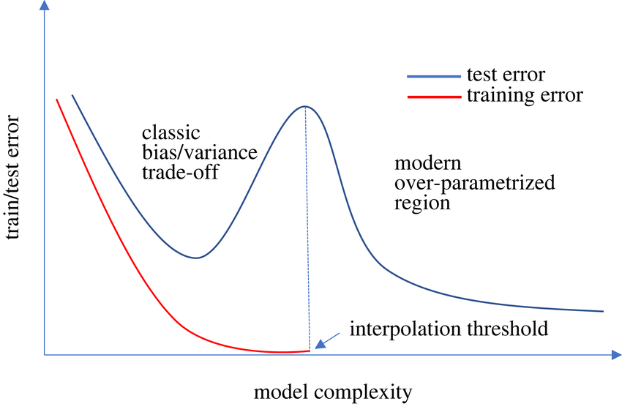
Notes:
As the model becomes large enough to perfectly fit (interpolate) the training data, the test error spikes sharply — this is the interpolation threshold.

Slide 13
Concept 5: Calibration
• Accuracy (AUC) ≠ Confidence
• Calibration: When model says 90%, is it 90% correct?
• Method: Calibration Plot
• Well-calibrated = 45° line
[1] Park SH, Han K. Radiology 2018
[3] Kocak B et al. Eur Radiol. 2021.
Notes:
Calibration distinguishes between discrimination and confidence.
Use calibration plots and Hosmer-Lemeshow test.
Grouping Subjects: Subjects are first grouped into strata based on similar predicted probability values generated by the diagnostic or predictive model, typically by deciles of the predictions³.
Calculation: For each of these groups (or deciles), the observed probability is the real probability of the outcome (e.g., the disease state) in that group⁴⁴.
It is calculated as:
$$\text{Observed Probability} = \frac{\text{Number of subjects in the decile who actually had the disease}}{\text{Total number of all subjects in the decile}}$$
In essence, the model predicts a probability (x-axis), and the observed probability (y-axis) is the actual fraction of patients in that predicted group who experienced the outcome

Slide 14
Concept 6: Clinical Utility
• Accuracy may not equal patient benefit
• Method: Decision Curve Analysis (DCA)
• Plots net benefit
• Compares model to Treat All/None
• Model useful only where it beats defaults.
[1] Park SH, Han K. Radiology 2018
[3] Kocak B et al. Eur Radiol. 2021.
Notes:
DCA evaluates clinical value beyond metrics.

Slide 15
Concept 7: Reporting for Reproducibility
• Check Inputs: Feature Reliability
• Report Variability: 95% CI
• Use Checklists: TRIPOD, STARD, CLAIM
[2] Tang A et al. CARJ 2018
[3] Kocak B et al. Eur Radiol. 2021.
Notes:
Reproducibility requires reliable inputs, reporting intervals, and checklists.

Slide 16


Slide 17
Machine learning-based study pipeline

Slide 18
Key methodological concepts according to four main study steps

Slide 19
Simplified validation strategies in machine learning.
(a) Splitting data into training and testing sets. institution or another scanner, the method is called independent. (b) Cross-validation. (c) Random sampling. (d) Nested cross-validation.

Slide 20
Sample Size Estimation in ML (Balki et al., 2019)
• No universal formula exists for ML in medical imaging.
• Two main methods: Pre hoc (theoretical) & Post hoc (curve fitting).
• Empirical learning curves provide task-specific guidance.

Slide 21
Why Sample Size Matters
• Directly impacts model generalization and reproducibility.
• Overfitting risk is higher with limited data.
• Different tasks (e.g., classification vs segmentation) need different sample sizes.

Slide 22
Pre Hoc Estimation
• Based on algorithm parameters and error tolerance
• Example: Baum–Haussler bounds
• Advantage: a priori planning
• Limitation: ignores data complexity and noise

Slide 23
Post Hoc Estimation (Curve Fitting)
• Uses empirical performance vs. sample size
• Fits learning curve: A(N) = A∞ - c / N^α
• Advantage: task-specific & grounded in real data.
• Limitation: requires a pilot dataset.
Notes:
The equation states that the final performance $A(N)$ is equal to the ultimate maximum performance $A_{\infty}$ minus a term that represents the performance deficit due to limited data: $\frac{c}{N^{\alpha}}$.
As the sample size $N$ increases, the denominator ($N^{\alpha}$) gets larger, causing the deficit term ($\frac{c}{N^{\alpha}}$) to get smaller. When this deficit term approaches zero, the performance $A(N)$ gets closer to $A_{\infty}$.
In summary, this formula is used to extrapolate the final expected performance ($A_{\infty}$) by fitting this specific curve to actual empirical performance data gathered at various sample sizes.

Slide 24
Step 1–3: Practical Example
Step 1: Train on increasing N, record accuracy.
Step 2: Fit learning curve.
Step 3: Solve for target accuracy.
Result: N ≈ 2,275 samples to reach 90% accuracy.

Slide 25
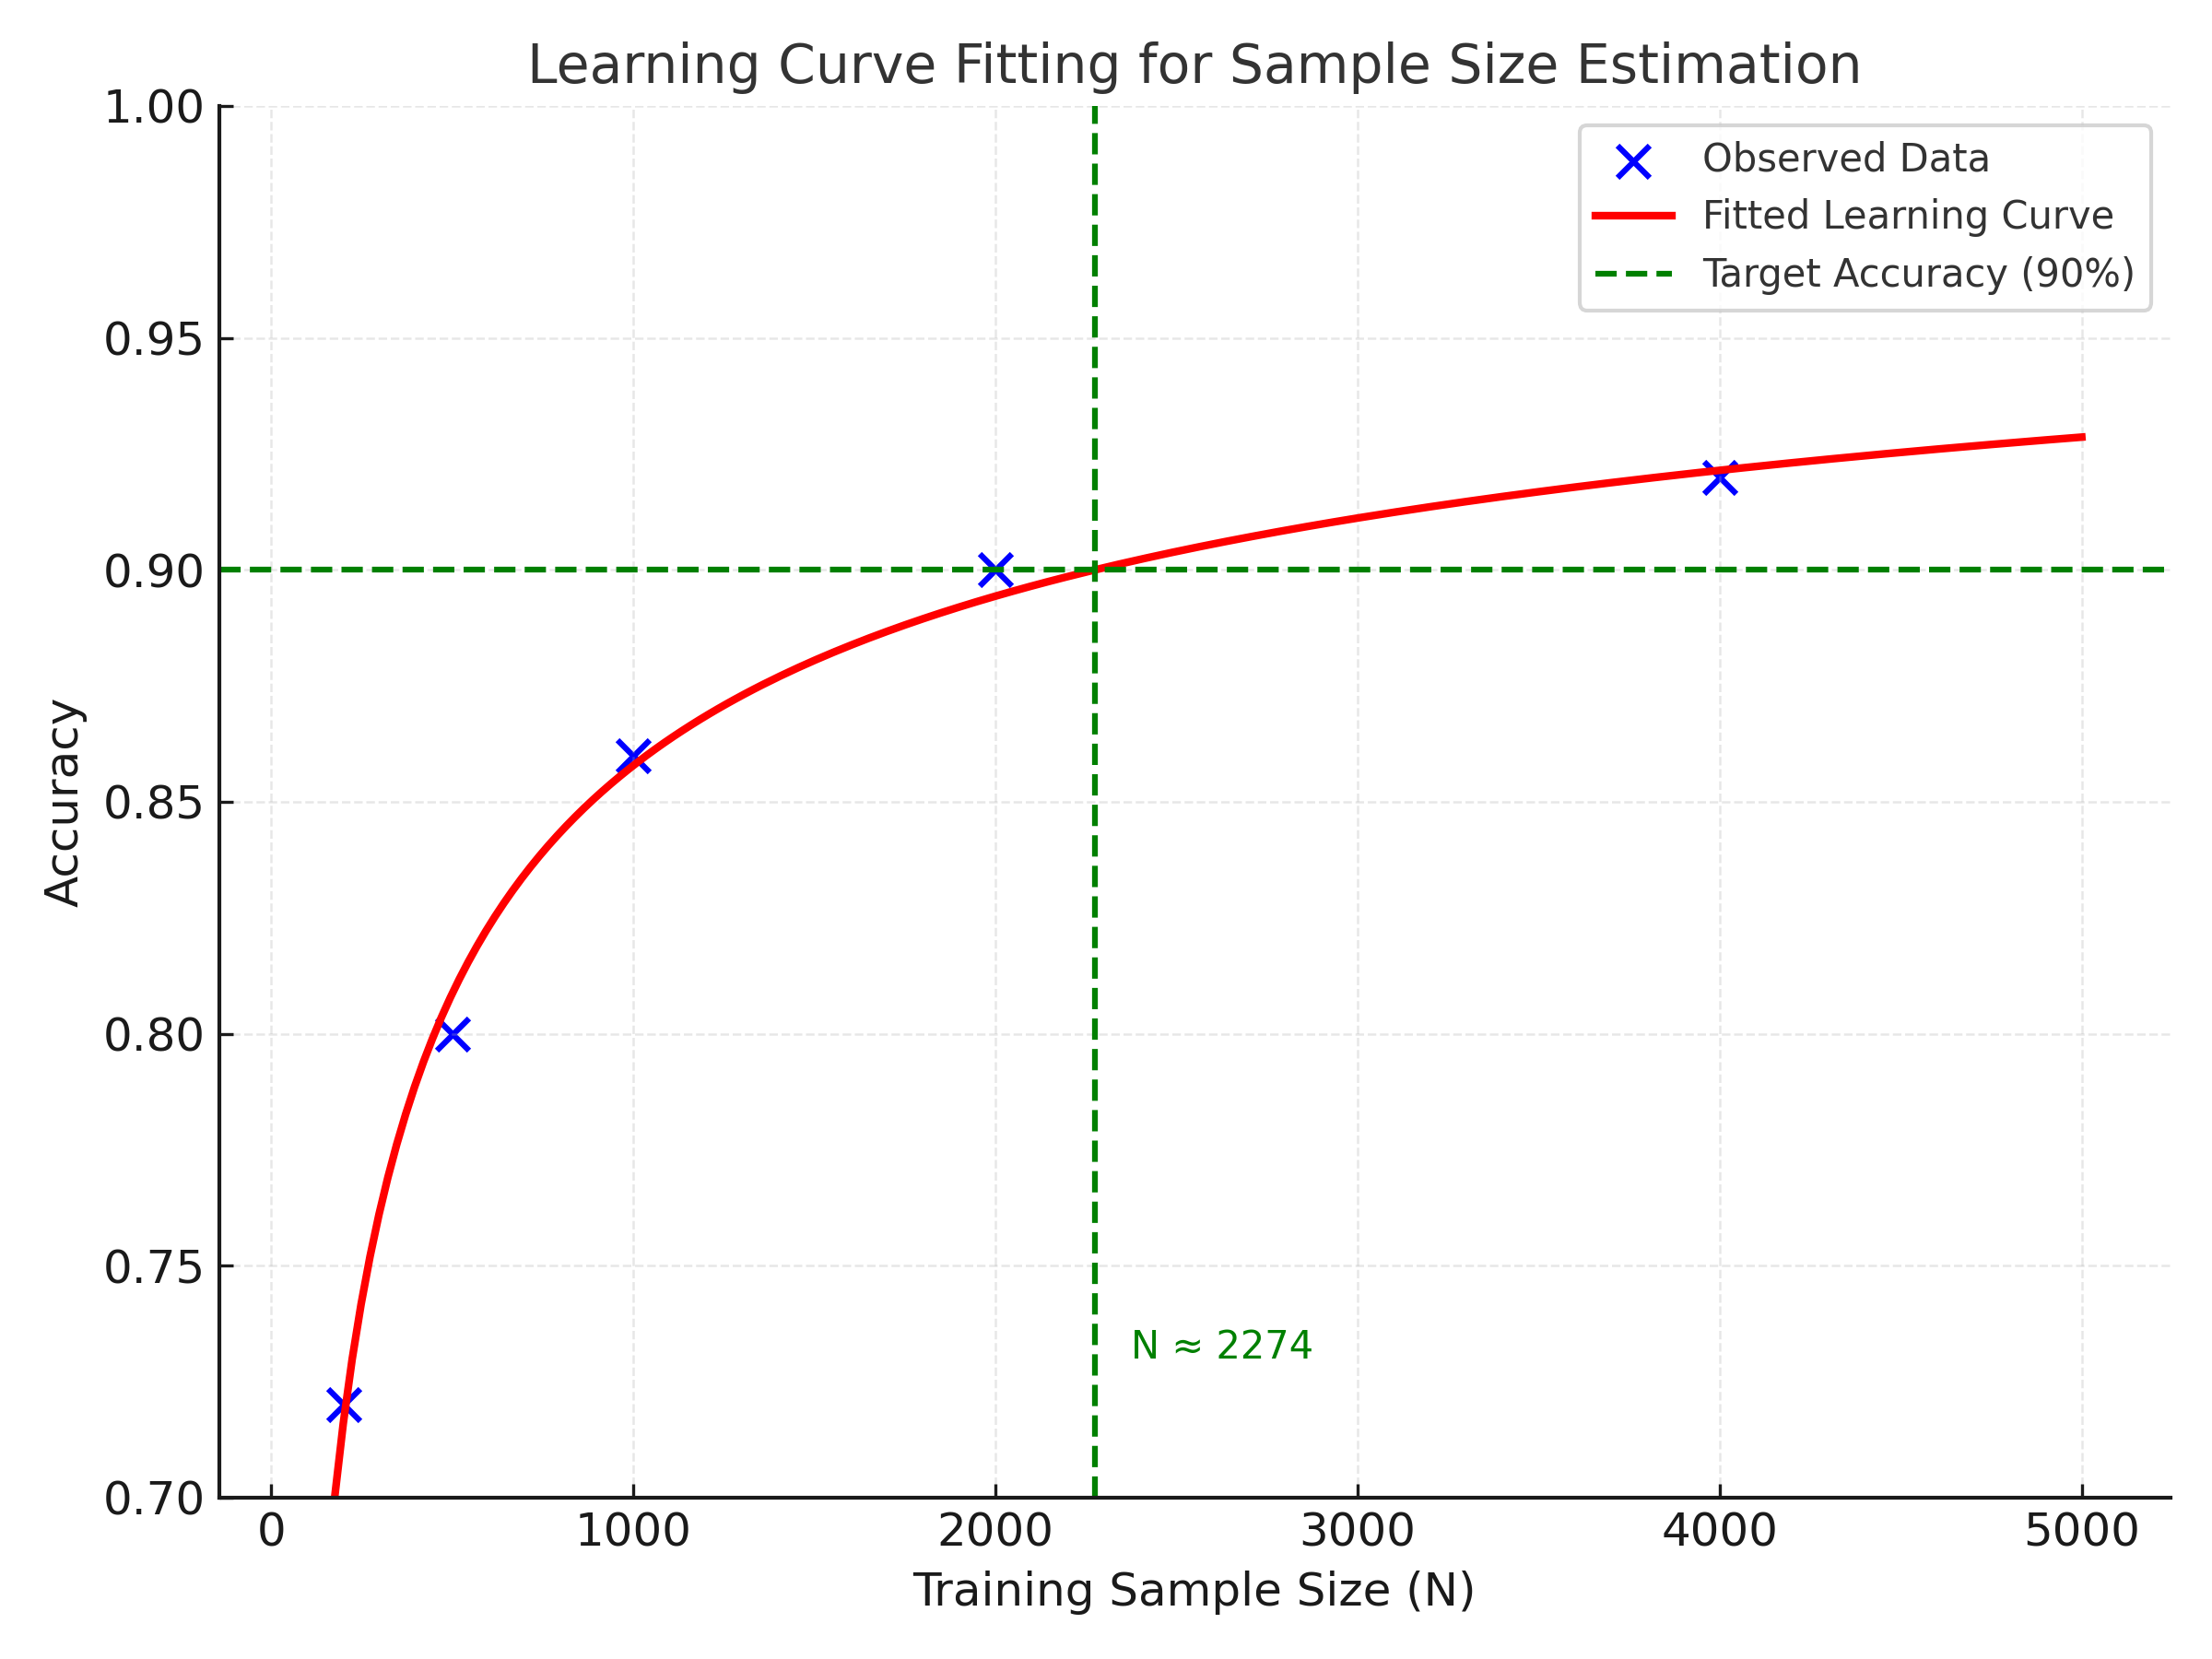
Learning Curve Visualization
Fitted learning curve shows saturation near 2,274 samples.
• Blue = observed data
• Red = fitted curve
• Green = target accuracy

Slide 26
Statistically Comparing Machine Learning Models: Is 92% Really Better Than 91%?
Notes:
(Self-Introduction)
Hi everyone, I'm Pascal Tyrrell. We've all been in this situation: you've built two models, a new one and a baseline. Model A gets 91% accuracy, and your new Model B gets 92%. Is it time to publish? Is Model B really better, or did you just get lucky with your data split?
This is a question of statistical hypothesis testing. We can't just compare the single "point estimates" (92% vs 91%). We have to account for the variance in our measurements. The test we use depends entirely on how we validated our models.
Today, we'll cover the right (and wrong) ways to do this.

Slide 27
The Two Validation Scenarios
• Scenario A: Single Train/Test Split
- Split once (e.g., 80/20)
- One accuracy for Model A and one for Model B on the same test set
- n = 1
• Scenario B: k-Fold Cross-Validation
- Split data k times (e.g., 10-fold)
- k accuracies for Model A and k for Model B
- n = k
Notes:
Everything comes down to these two scenarios.
In Scenario A (Single Split), you have a single test set, giving only one accuracy score per model—n = 1. You can't run a t-test on a single number, so we must test the predictions themselves.
In Scenario B (k-Fold CV), you have multiple scores (e.g., k = 10). This gives data amenable to a t-test.
Crucially, the statistical test must match the validation scenario.

Slide 28
Scenario A — Comparing on a Single Test Set
Since n = 1, we can't test the scores. We must test the predictions.
• Method: McNemar's Test
- Paired, non-parametric (classification)
- Tests differences in the errors made by the two models
- Uses a 2×2 contingency table of disagreements
2×2 Contingency Table:
 | Model B: Correct | Model B: Incorrect
Model A: Correct | n11 (Agree) | n10 (A better)
Model A: Incorrect | n01 (B better) | n00 (Agree)
Notes:
In the single split scenario, don't use a t-test. Compare per-sample predictions.
McNemar's Test is paired because both models predict on the same instances. It focuses on the disagreement cells n10 and n01.
H0: n10 = n01 (same error rate).
Statistic: X^2 = (n10 − n01)^2 / (n10 + n01).

Slide 29
Scenario B — Comparing on k-Fold CV
We have k performance scores per model — this is a paired data problem.
• Paired t-test
Step 1: For each fold i, compute d_i = Acc_{A,i} − Acc_{B,i}
Step 2: Collect k differences (d1, …, dk)
Step 3: One-sample t-test on {d_i} to test mean(d) ≠ 0
Notes:
Model A and Model B scores on the same fold are paired (same train/test split).
Use a paired t-test:
H0: μ_d = 0 (no mean difference).
If p < 0.05, conclude a significant difference between models.

Slide 30
Pitfall — The 'Dirty Secret' of the Paired t-test for CV
Assumption: independence of observations.
• Problem: k-fold CV results are not independent
- Training sets for folds overlap heavily (e.g., 80% in 10-fold)
- Fold accuracies are correlated
• Result: Paired t-test is liberal (inflated Type I error)
Notes:
The paired t-test assumes independent observations, which is violated in k-fold CV due to overlapping training sets. This inflates the Type I error rate (more false positives), making results too optimistic.

Slide 31
A Better (but Complex) t-test — 5×2 CV
Method: 5×2 CV Paired t-test (Dietterich, 1998)
How it works:
1) Perform 2-fold CV (50/50 train/test), compute p1 = Acc_A − Acc_B
2) Swap train/test, compute p2 = Acc_A − Acc_B
3) Repeat the above (with new random shuffle) 5 times
Result: 5 independent pairs → run t-test on these
Notes:
The 5×2 CV paired t-test reduces dependence by using repeated, nearly independent 2-fold splits. It is more statistically robust but computationally heavier, which limits adoption in practice.
The $5 \times 2$ CV is primarily favored for its elegant way of generating 5 independent pairs of differences for a classic t-test, but the trade-off in high variance due to the small training size often outweighs this statistical benefit in modern, data-hungry machine learning contexts.

Slide 32
A Powerful Alternative — Bootstrapping
Non-parametric bootstrap on k-fold paired results
Goal: 95% CI for the mean performance difference
Procedure:
1) Start with k paired results: (Acc_A,i, Acc_B,i)
2) Resample (with replacement) k pairs
3) Compute mean difference for the resample
4) Repeat (e.g., 5,000 times) to get a distribution (5 folds will result in a distribution of 3125 possible values)
5) 95% CI = [2.5th, 97.5th] percentiles
Decision: If CI excludes 0 → significant
Notes:
Bootstrapping avoids normality assumptions and handles small k. By resampling paired fold results, you empirically derive the sampling distribution of the mean difference and form a robust CI.

Slide 33
Summary & Recommendations
Single (large) test set:
• Good: McNemar's Test (classification)
• Better: Bootstrapping on test predictions
k-Fold CV:
• Good (common): Paired t-test on k results (liberal)
• Better (robust): 5×2 CV paired t-test or bootstrapping paired results
• Best: Bootstrapping paired results
What NOT to do:
• Never use independent (unpaired) t-tests on paired k-fold data
• Never just compare point estimates (e.g., 92% vs 91%)
Notes:
Cheat sheet:
• Single test set → McNemar or bootstrap predictions.
• k-fold → paired t-test (with caveats) or better: 5×2 CV test / bootstrap.
• Avoid independent t-tests on paired data and eyeballing final numbers.

Slide 34
What About Continuous Outcomes?
“My models predict age, and I'm using MAE. Now what?”
• Logic is identical: same two scenarios (Single Split vs k-Fold)
• Goal is identical: test whether performance difference is real
• Data changes: use per-sample Absolute Errors (AE) = |y_i − ŷ_i|
Notes:
For regression metrics (MAE/RMSE), the statistical framework is the same. Instead of correct/incorrect labels, use paired lists of per-sample errors (absolute or squared), then compare appropriately.

Slide 35
Scenario A — Single Test Set (MAE)
n = 1 for overall MAE → test underlying errors
Methods:
• Paired t-test on per-sample AE lists (Model A vs Model B)
• Wilcoxon Signed-Rank Test (safer non-parametric alternative)
How:
1) For each sample i, compute AE_A,i and AE_B,i
2) Run paired test on these paired error lists
Notes:
You cannot test a single MAE value. Use per-sample errors to form paired lists. Wilcoxon Signed-Rank is robust to non-normal, skewed error distributions often seen in practice.

Slide 36
Scenario B — k-Fold CV (MAE)
We have k MAE scores per model → paired data
• Paired t-test on differences d_i = MAE_A,i − MAE_B,i
• Robust alternative: Wilcoxon Signed-Rank on {d_i} when k is small
• Bootstrapping the k paired scores to build a 95% CI for mean difference
Notes:
Procedure mirrors the classification case: compute fold-wise differences and test the mean difference. With small k or non-normal differences, prefer Wilcoxon or bootstrap CIs.

Slide 37
Summary — Tests for Continuous Metrics (MAE/RMSE)
Single (large) test set:
• Good: Paired t-test on per-sample AE lists
• Better: Wilcoxon Signed-Rank on AE lists
k-Fold CV:
• Good: Paired t-test on k MAE scores
• Better: Wilcoxon on {d_i} for small k or Bootstrapping paired scores for CI
Avoid:
• Independent t-tests on paired k-fold data
• Comparing only final numbers (e.g., MAE 2.1 vs 2.3)
Notes:
For continuous outcomes, pairwise comparisons and robust, assumption-light methods (Wilcoxon, bootstrap) provide defensible conclusions. Always report effect sizes and confidence intervals alongside p-values.

Slide 38
Agreement vs. Reliability: Understanding Reproducibility in Clinical Measurement
Journal of Clinical Epidemiology 59 (2006) 1033–1039
Notes:
Today we're going to discuss two of the most important concepts in clinical measurement, which are often confused: Agreement and Reliability.
Both fall under reproducibility: whether repeated measurements give similar results.
But “similar” can mean two different things. This presentation will clarify the difference and guide when to use each.

Slide 39
Two Different Questions
1. How close are the measurements to each other?
• AGREEMENT – Quantifies measurement error
2. Can I tell my subjects apart, even with errors?
• RELIABILITY – Relates error to between-subject variability
Notes:
Agreement and reliability answer fundamentally different questions.
Agreement is about how close repeated measurements are.
Reliability is about distinguishing patients despite errors.

Slide 40
Concept 1: Agreement
• Focus: Measurement error
• Question: How close are repeated results?
• Key Property: Pure instrument characteristic
• Parameters:
- Standard Error of Measurement (SEM)
- Limits of Agreement (Bland-Altman)
- % within predefined range (e.g., 10°)
Notes:
Agreement focuses on closeness of repeated measurements, independent of sample variability. Common measures: SEM, Bland-Altman, % agreement within range.

Slide 41
Concept 2: Reliability
• Focus: Distinguishing subjects
• Question: Can we tell patients apart despite error?
• Key Property: Depends on heterogeneity
• Formula: Variability between subjects / (between subjects + error)
• Parameter: ICC
Notes:
Reliability depends on sample variability. Even with identical measurement error, reliability can vary drastically between heterogeneous and homogeneous groups.

Slide 42
Case Study: The Shoulder Example
Parameter | Affected Shoulder | Nonaffected Shoulder
% within 10° | 72% | 72%
LoA | -18.8° to 20.4° | -17.9° to 19.7°
ICC | 0.83 (Good) | 0.28 (Poor)
Agreement same, reliability different.
Notes:
This shoulder example shows how measurement error can be identical but ICC values differ drastically because of patient variability.
The low ICC tells you that for the nonaffected shoulder measurements, the measurement error is large relative to the small differences that exist between individual subjects.
$$\text{ICC} = \frac{\text{Variance}_{\text{True Subject Differences}}}{\text{Variance}_{\text{True Subject Differences}} + \text{Variance}_{\text{Error}}}$$
For the nonaffected shoulder, the denominator is dominated by the $\text{Variance}_{\text{Error}}$. This means the instrument/rater may be precise (giving similar results most of the time, leading to the $72\%$ agreement), but it is not effective at distinguishing one nonaffected shoulder from another. This is crucial information for clinicians because it means any small measured difference between two nonaffected patients is likely meaningless noise, not a true biological difference.

Slide 43
Why the Difference? The Role of Heterogeneity
Parameter | Affected | Nonaffected
SD | 17.60° | 7.60°
ICC | 0.83 | 0.28
• High variability → error small in context → high ICC
• Low variability → same error big in context → low ICC
Notes:
Group heterogeneity explains the ICC difference. High SD means measurement error is relatively small, resulting in high reliability.

Slide 44
Agreement vs. Reliability: The Math
• Agreement: SEM = √(σ_error²)
- SEM_agreement = √(σ_raters² + σ_residual²)
• Reliability:
ICC = σ_patients² / (σ_patients² + σ_raters² + σ_residual²)
Notes:
Mathematically, agreement reflects absolute error, while reliability is a ratio of patient variability to total variability (including error).

Slide 45
When to Use Which?
Use RELIABILITY (ICC) for…
• Discrimination – Distinguishing subjects/groups
• Diagnostic/prognostic tools
Use AGREEMENT (SEM, LoA) for…
• Evaluation – Measuring change within subjects
• Clinical follow-up and monitoring
Notes:
Reliability is for discriminative purposes. Agreement is for evaluative purposes—monitoring patient change over time.

Slide 46
Conclusion: Key Takeaways
• Agreement ≠ Reliability
• Agreement = Instrument error (use for evaluation)
• Reliability = Error + sample variability (use for discrimination)
• Agreement often more appropriate for clinical evaluation.
Notes:
Agreement and reliability are not interchangeable. Agreement is used for evaluating change, reliability for discriminating between subjects.

Slide 47
Segmentation: Key Metric Categories
1. Overlap-based metrics – Dice, IoU ✅ (most common)
2. Pixel-level metrics – Accuracy, Precision, Recall
3. Boundary-based metrics – Hausdorff Distance
4. Others: ASD, mIoU, PQ, VS

Slide 48
Dice Similarity Coefficient (DSC)
Formula: Dice = 2|A ∩ B| / (|A| + |B|)
• Measures overlap between prediction and ground truth
• Range: 0 (no overlap) to 1 (perfect overlap)
• Advantages: easy to interpret, handles class imbalance well
• Widely used in medical imaging

Slide 49
Intersection over Union (IoU)
Formula: IoU = |A ∩ B| / |A ∪ B|
• Also known as the Jaccard Index
• More strict than Dice
• Common in remote sensing & autonomous driving
• Relation: Dice = 2*IoU / (1 + IoU)

Slide 50
Accuracy, Precision & Recall
Accuracy = (TP + TN) / (TP + FP + TN + FN)
Precision = TP / (TP + FP)
Recall = TP / (TP + FN)
• Accuracy can be misleading with imbalance
• Precision shows positive correctness
• Recall shows detection ability
• Good for class balance understanding

Slide 51
Hausdorff Distance (HD)
• Measures worst-case boundary error
• Captures shape accuracy and edge alignment
• Lower values = better
HD(A,B) = max{sup_a inf_b d(a,b), sup_b inf_a d(a,b)}

Slide 52
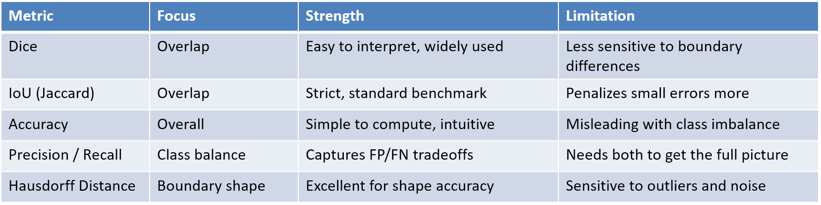
Choosing the Right Metric

Slide 53
Best Practice
• Combine multiple metrics for full picture
• Typical combos:
🩺 Medical: Dice + HD
🚘 Driving: IoU + mIoU
🛰️ Remote sensing: IoU + Precision/Recall
• Visual inspection remains important

